Slide 1
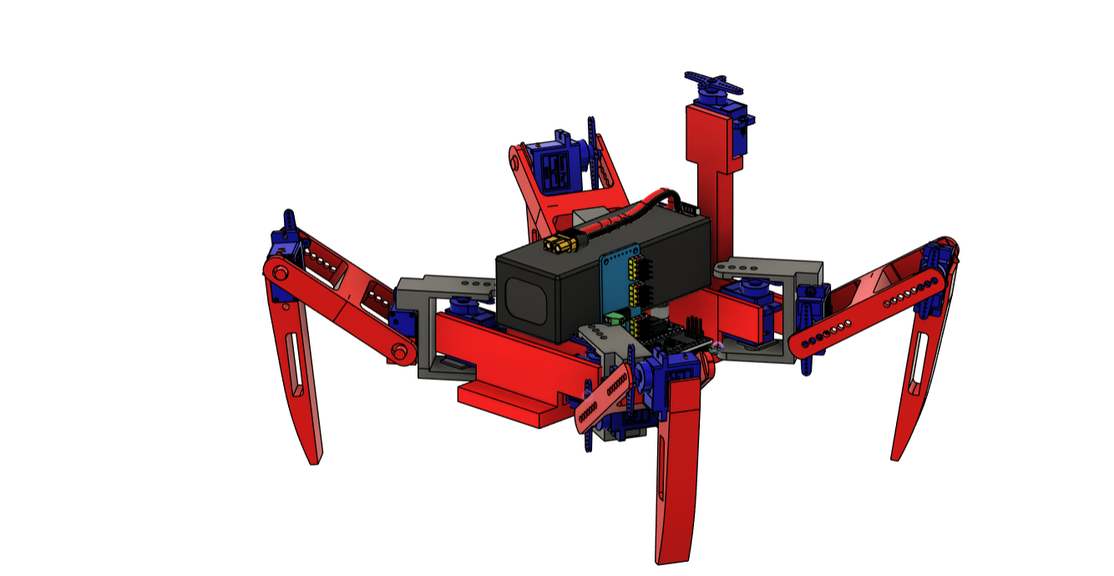
BIO inspired Robot for Disaster Response
Presented by the ERROR-405
E-MINDS Hackathon 2.0

Slide 2
The Challenge’s
Disaster environments introduce multi-dimensional constraints that severely limit the operation of conventional mobile robots. These challenges arise due to complex, unpredictable, and dynamically changing conditions:
Disaster environments challenge robots due to:
Highly uneven terrain and unstable surfaces
Restricted narrow spaces that block wheeled robots
Sensor interference from dust, darkness, and debris
Loss of GPS and unreliable mapping conditions
High thermal and mechanical stress on components
Communication failures due to collapsed infrastructure

Slide 3
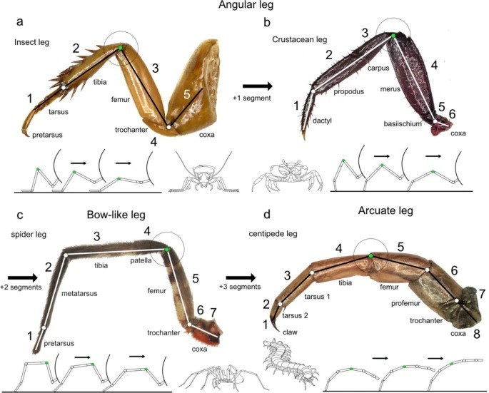
BIO-Inspired Design
The BIO-inspired walking robot features a unique locomotion system that allows it to traverse challenging environments. By mimicking the natural movement of crabs / insects, the design integrates 4 articulated legs(Angular Leg), enhancing stability and maneuverability on uneven surfaces. This innovative approach enables effective navigation through rubble and narrow spaces, making it an ideal solution for disaster response scenarios where traditional robots struggle.
Terrain Adaptability

Slide 4
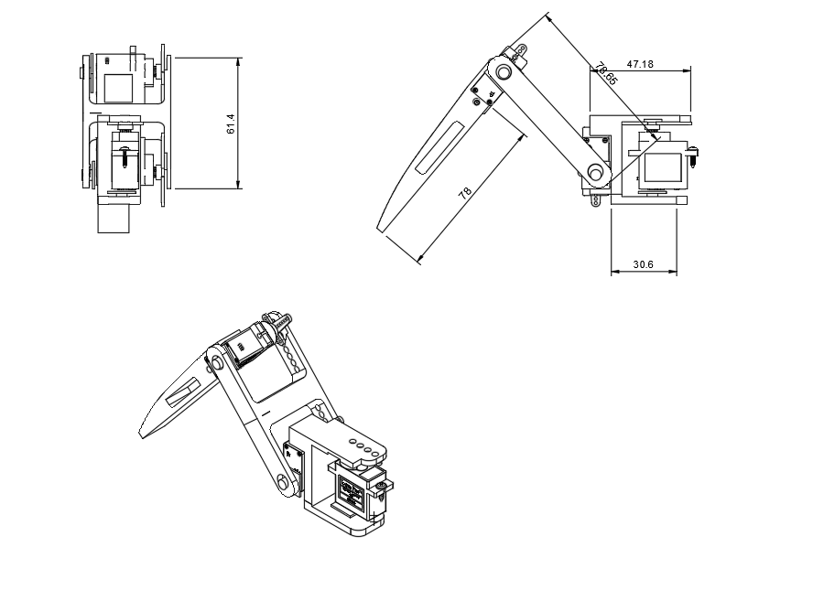
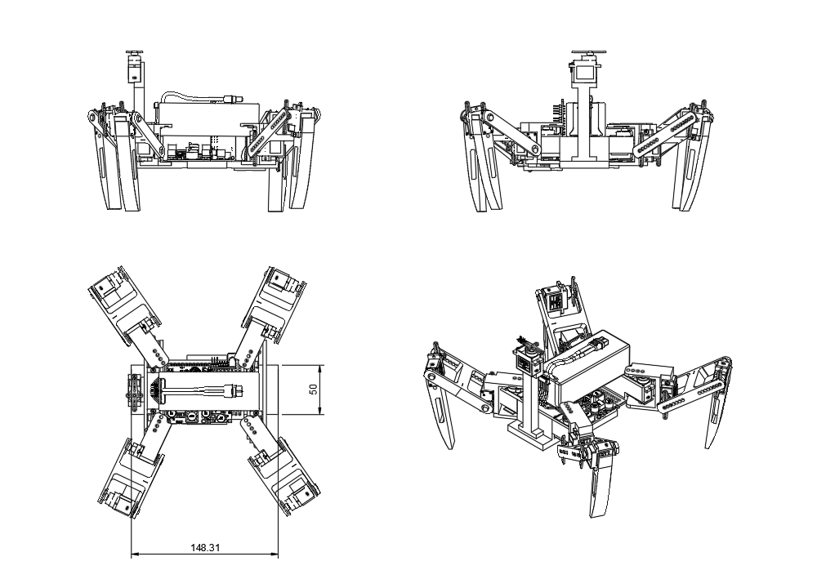
Computer Aided Drawing

Slide 5
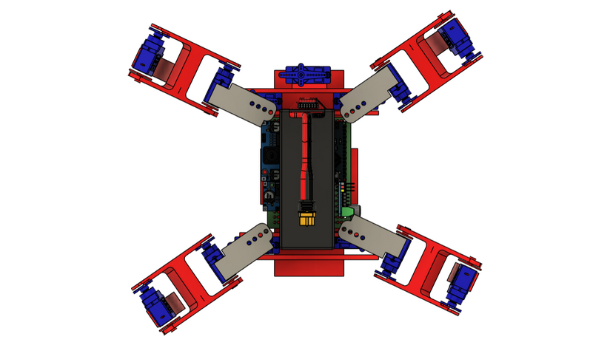
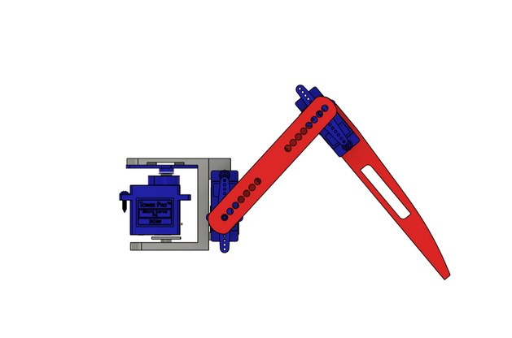
01
03
02
Structural Design
CAD Optimization
Emphasizes compact and modular features for efficiency.
Focuses on structural integrity and efficiency.
Leg Mechanism
Showcases the unique multi-link design for mobility.

Slide 6
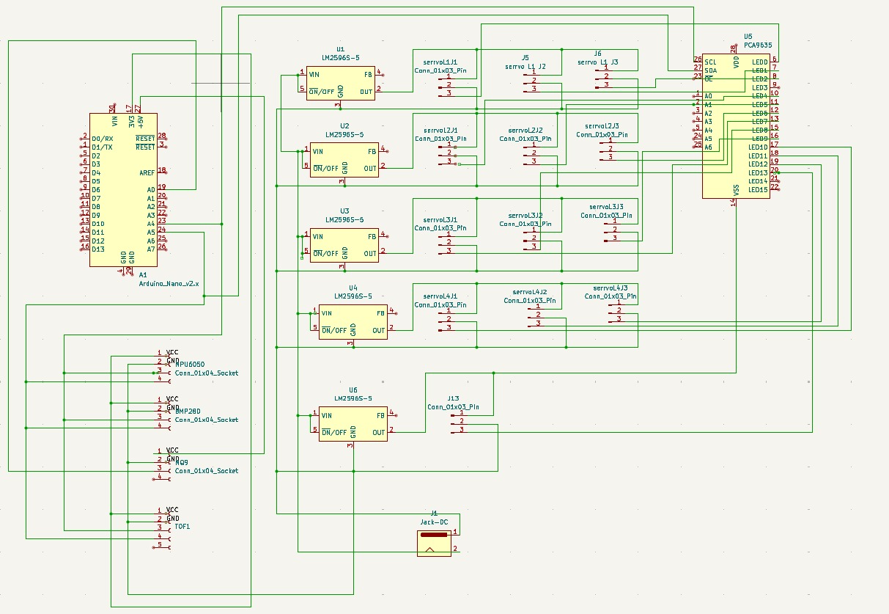
Circuit Diagram

Slide 7
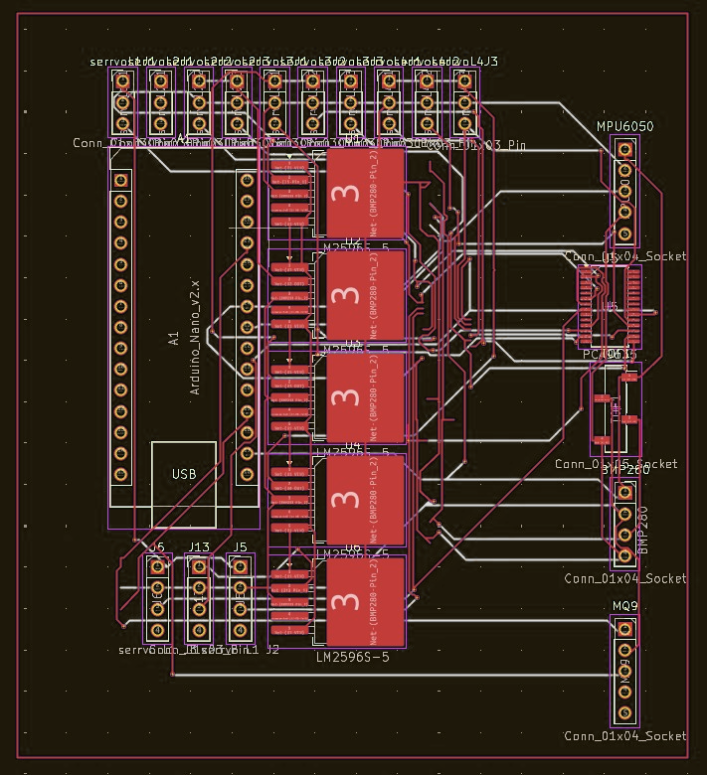
PCB Design

Slide 8
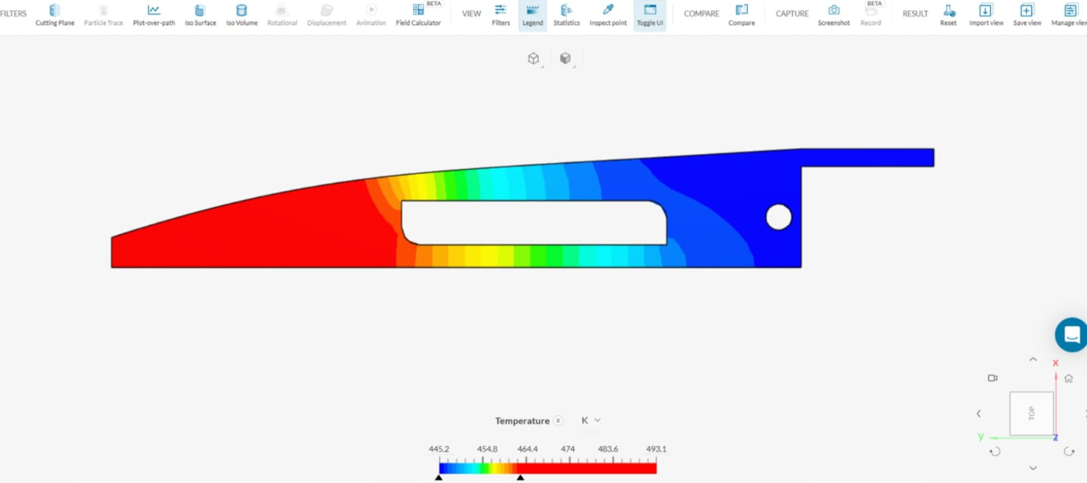
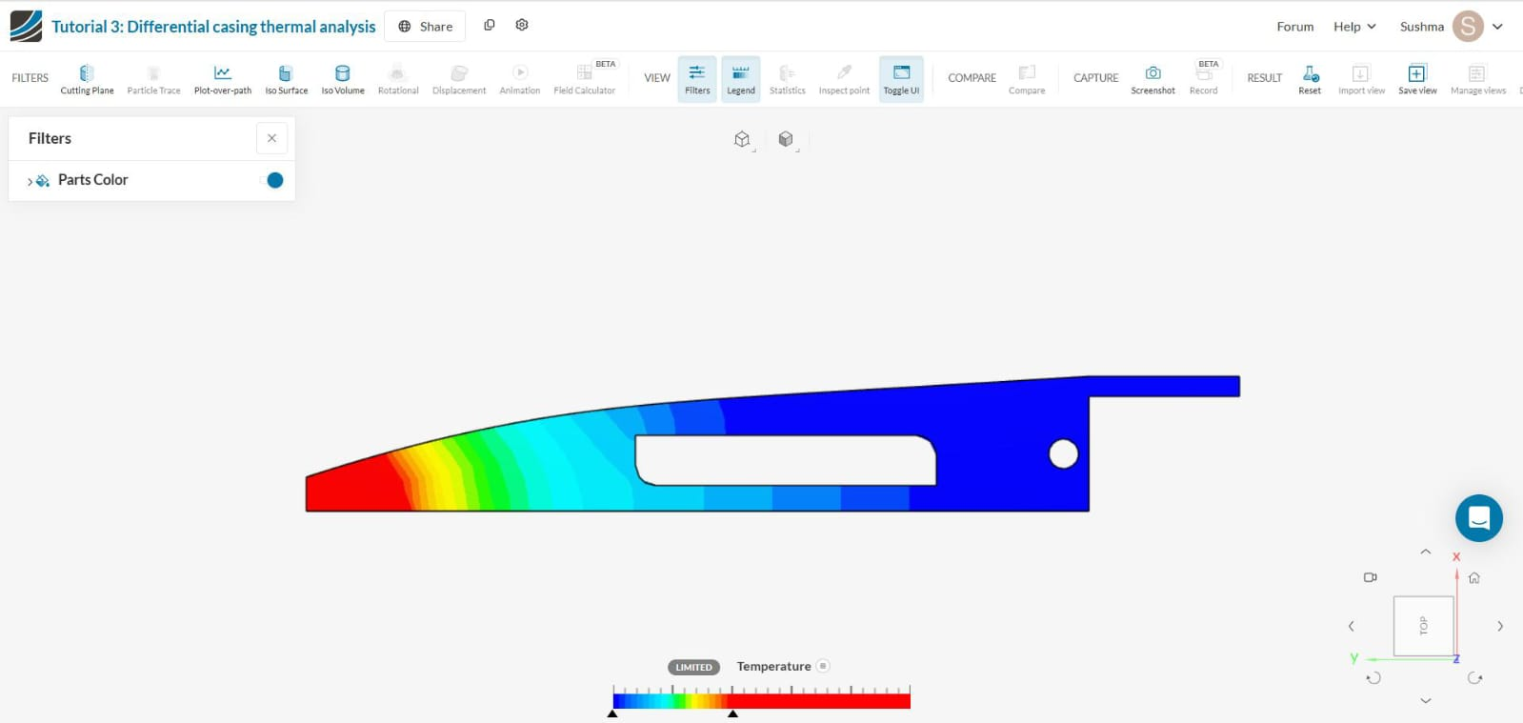
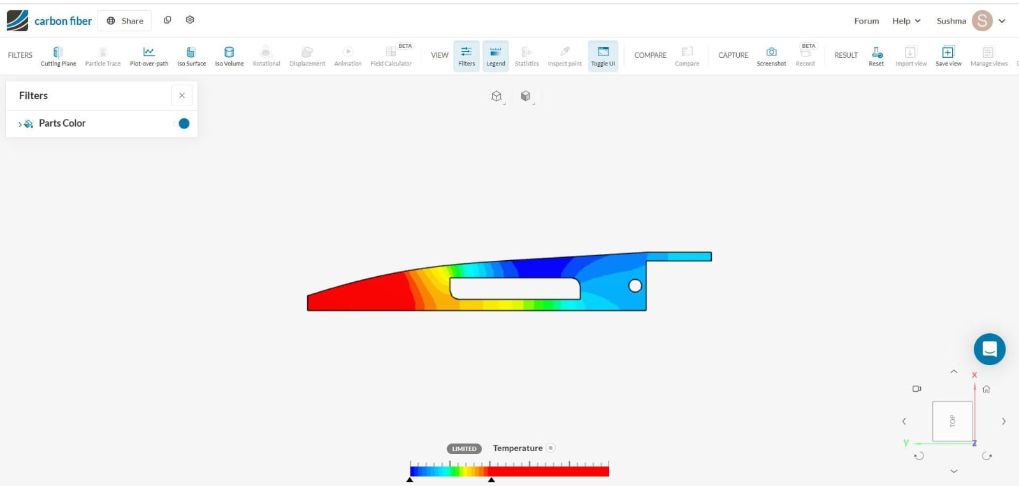
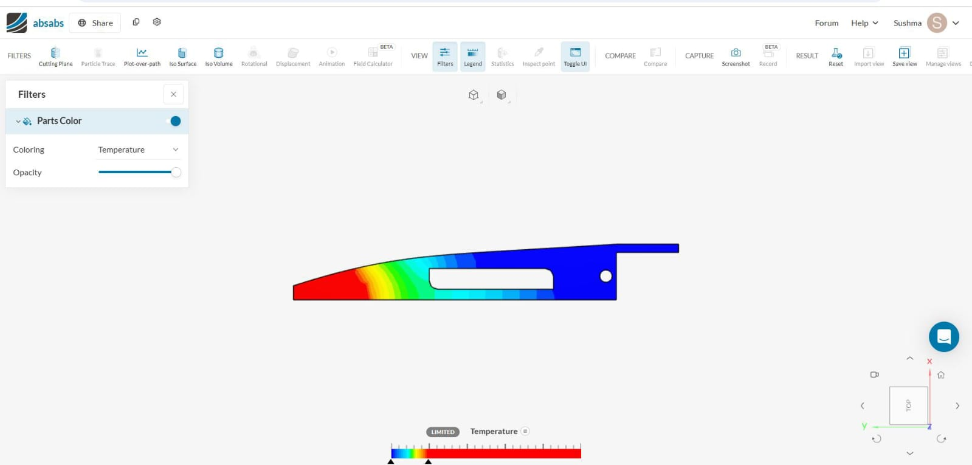
Heat transfer analysis
Stainless steel
carbon fiber
Nylon
ABS

Slide 9
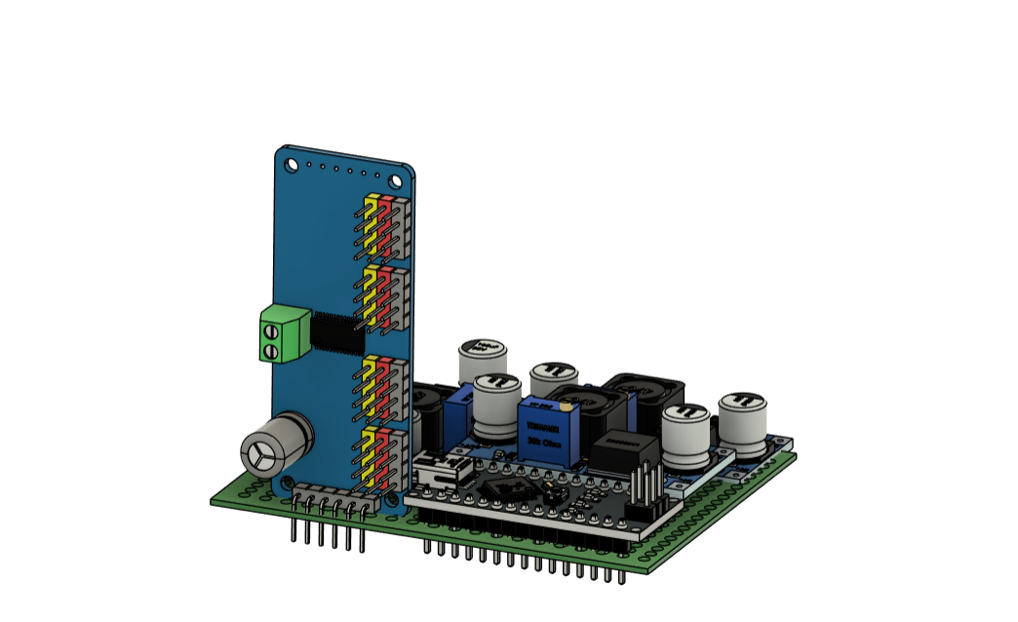
Microcontroller System
The two-microcontroller system consists of an Arduino Nano/Uno paired with an ESP32-CAM. The Arduino manages servo control and processes sensor data, while the ESP32-CAM is responsible for real-time video streaming and data communication via MQTT. This architecture enhances the robot's responsiveness and capability to handle complex tasks in disaster environments, ensuring efficient data processing and transmission.

Slide 10
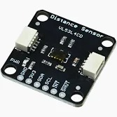
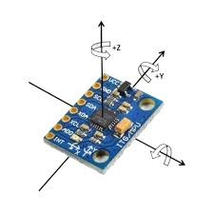
Key Sensors for Disaster Response
ToF Sensor
IMU Sensor
Accurate distance measuring
for environmental mapping.
Orientation tracking for
improved navigation stability.

Slide 11
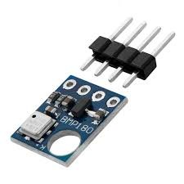
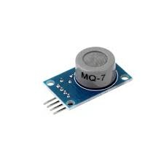
Key Sensors for Disaster Response
BMP 180
Accurate temperature and pressure measurement.
MQ-7
Carbon Monoxide (CO)
gas measurement.

Slide 12
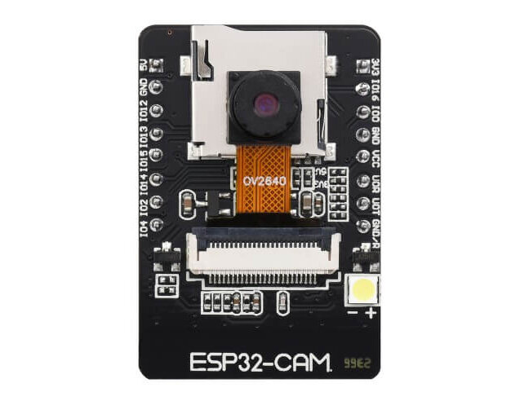
ESP32-CAM Functionality
The ESP32-CAM onboard camera server enables live video streaming at up to 30 FPS, providing crucial situational awareness during disaster response operations. Accessible through a browser or ROS dashboard, it enhances victim detection and teleoperation capabilities. This real-time feedback ensures that operators can effectively assess environments, improving decision-making and response times in critical scenarios.

Slide 13
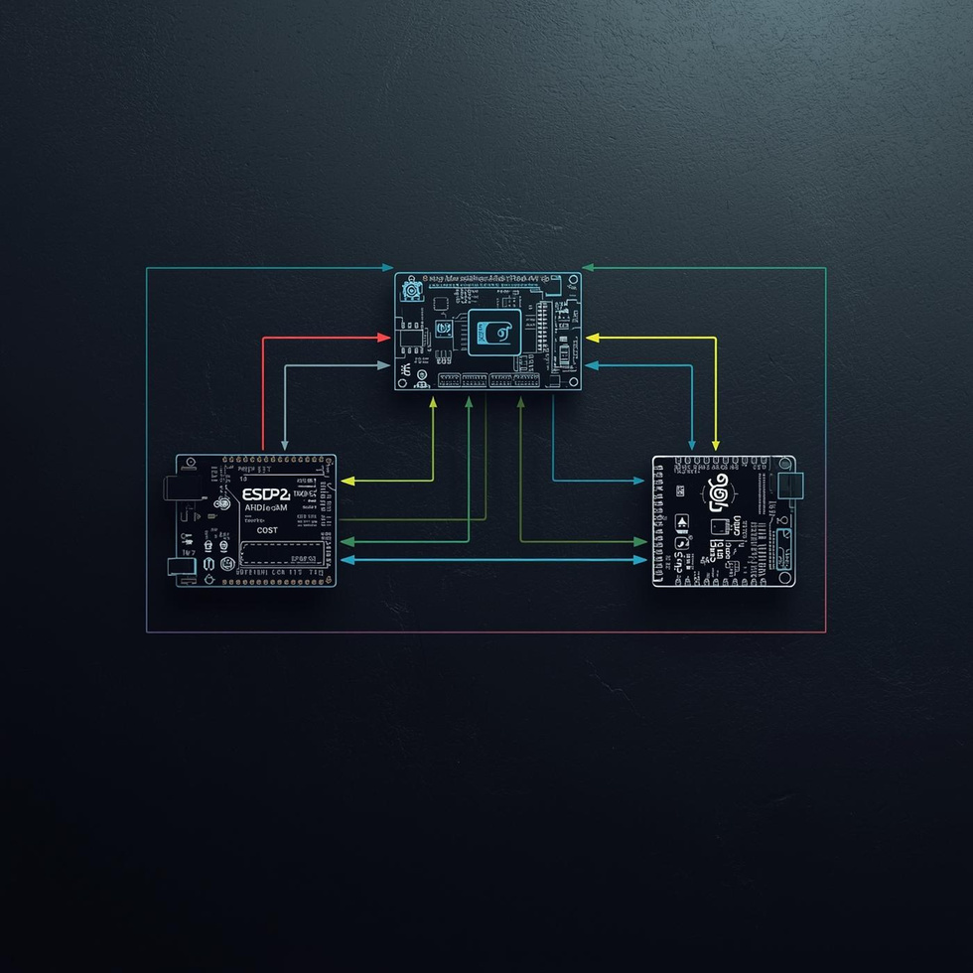
Data Handling
The system's data handling begins with the Arduino sending sensor data serially to the ESP32. This includes IMU, ToF sweep, and barometric readings. The ESP32-CAM processes this data, converting it into JSON format for efficient streaming. Using MQTT, the processed information is then published to a connected laptop, enabling real-time analysis and providing vital insights during disaster response operations.

Slide 14
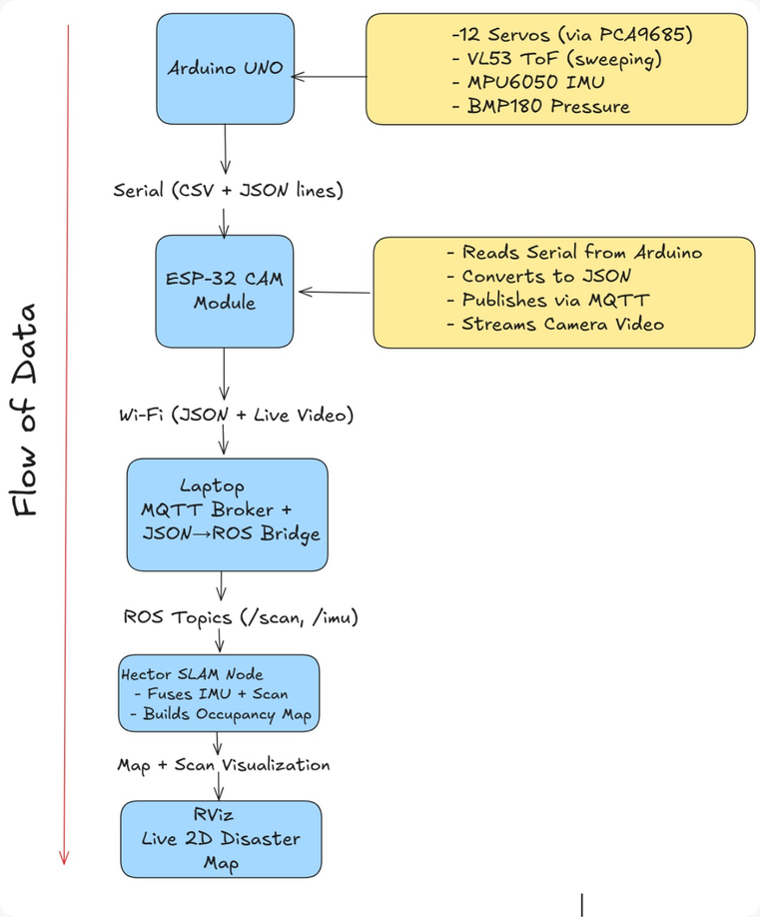
Data Flow Steps
The data flow from the sensors to visualization is crucial for robotic performance in disaster response. The Arduino collects sensor data including IMU, ToF, and environmental readings, sending it serially to the ESP32-CAM. This module converts the data into JSON format and streams it to a laptop, where ROS processes the information, enabling effective real-time mapping and analysis of the environment.

Slide 15
Hector SLAM Technology
Hector SLAM is a cutting-edge real-time mapping solution that empowers our bio-inspired robot to navigate complex and unfamiliar environments. By utilizing various sensors, it generates accurate and detailed maps, enhancing situational awareness in disaster scenarios and improving rescue operations.

Slide 16
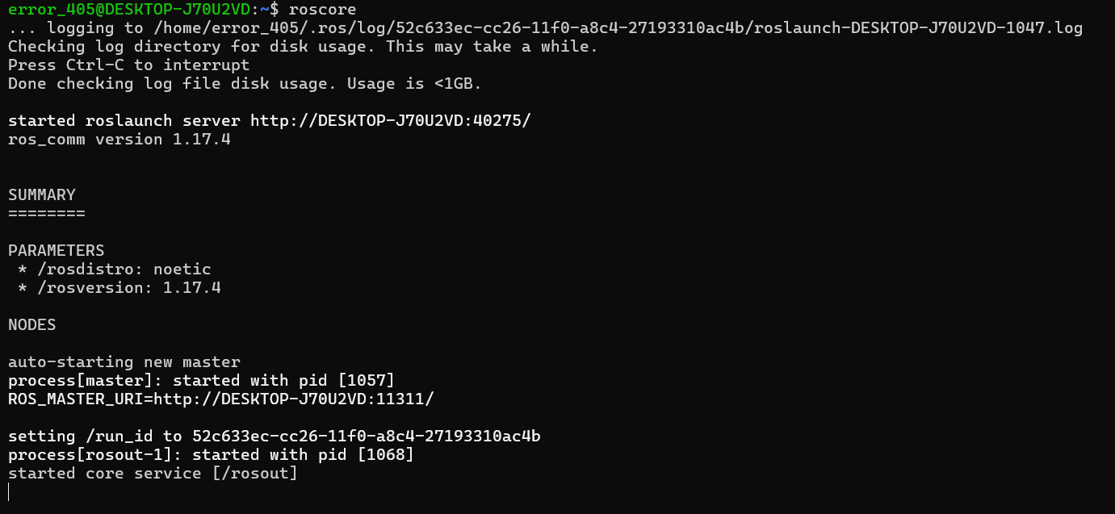
ROS Noetic Setup
The setup of ROS Noetic on WSL2 enables seamless integration of robotic applications and tools within a Windows environment. This configuration allows developers to leverage the power of Linux-based robotics software while maintaining their preferred operating system. The process involves installing WSL2, configuring necessary packages, and ensuring compatibility for efficient operation of robotic simulations and data analysis tasks.

Slide 17
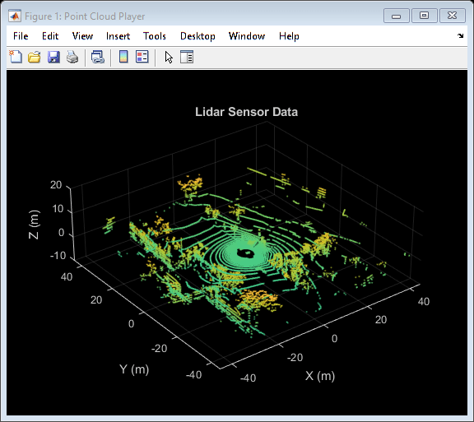
Mapping Pipeline Steps
The mapping pipeline is crucial for effective disaster response. It involves a sensor sweep to gather environmental data, which is then published via ROS messages. This data is fused using Hector SLAM, enabling the generation of a live occupancy grid map. Visualization in RViz allows operators to interpret the environment, enhancing situational awareness and decision-making during critical missions.

Slide 18
THANK YOU

